Slide 1
Intro to Wireshark & Bluetooth
October 28th, 2025
CS 151.1001
UNR CSE Department

Slide 2

Bluetooth

Slide 3

Bluetooth
Wireless protocol
Uses ISM radio bands
ISM– are portions of the radio spectrum reserved internationally for industrial, scientific, and medical (ISM) purposes.
Two types:
Low Energy (BLE)
Classic

Slide 4
BLE vs. Classic
BLE:
Data rate: 1Mbps
Small amounts of data
Ex: Fitbits
Low power consumption
BLE now serves all of the functions that Bluetooth Classic was designed for.
Classic:
Data rate: 3Mbps
Larger amounts of data
Ex: Video/audio streaming
Larger packet size
Almost all mobile devices support both (dual mode).

Slide 5
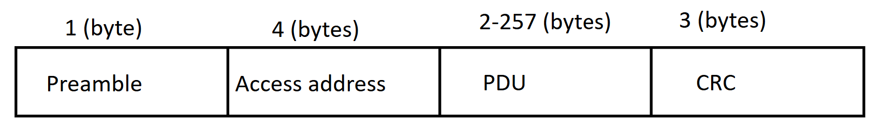
Bluetooth
Bluetooth defines two transmissions types: data and advertising transmissions.
All devices initially begin in advertising mode.
Advertising
Device discovery
Connection establishment
Data
Bidirectional connection between devices
Bluetooth LE packet format:

Slide 6
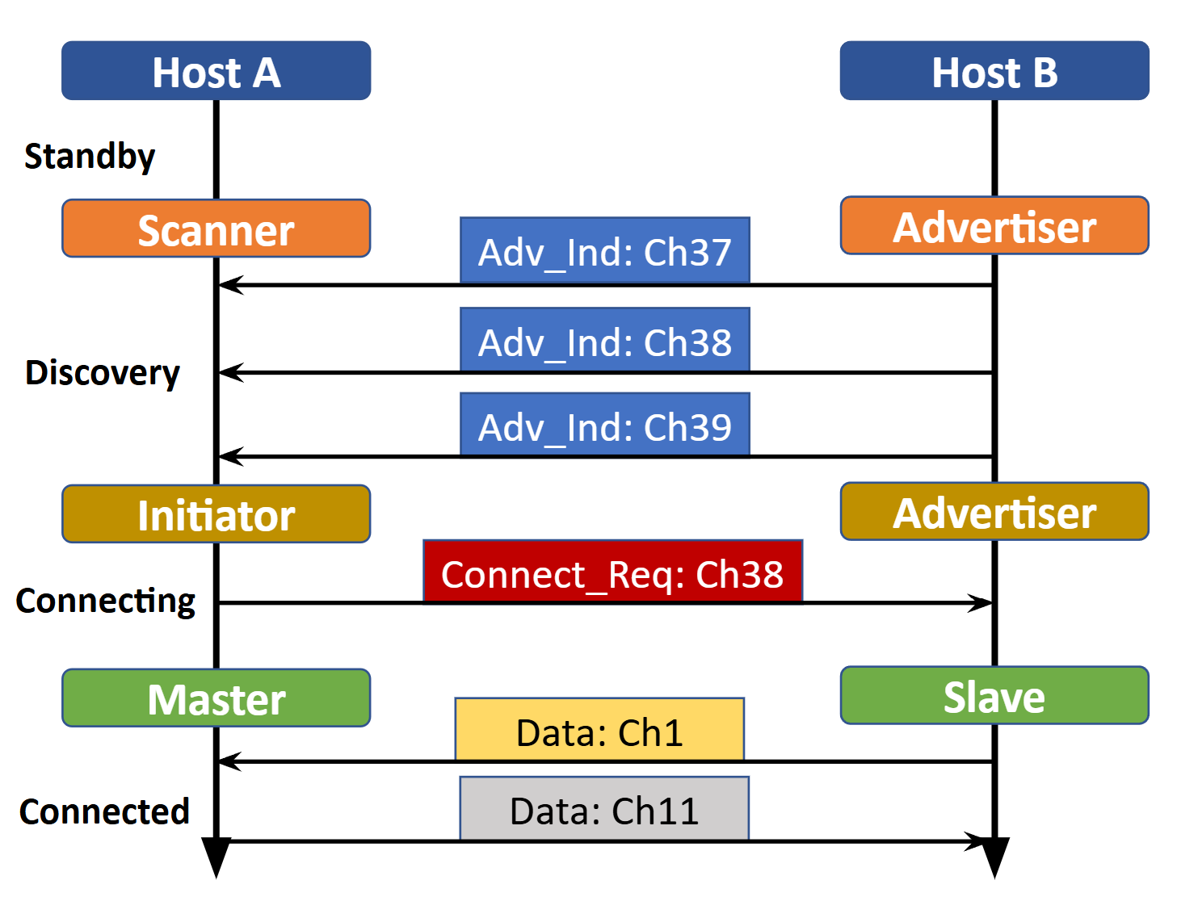
Bluetooth
Initially devices are in Standby state.
Devices enter a Discovery state where the device wishing to be discovered becomes the Advertiser and host wishing to connect becomes a Scanner.
The Advertiser sends advertising packets containing basic information about the host.
All Scanners receive these packets.

Slide 7

Bluetooth Attacks
Bluejacking– sending unsolicited messages to a Bluetooth-enabled device
Bluesnarfing– extracting and stealing stored data.
Hackers pair to a victim’s device by skipping the code pairing process.
Bluetooth v4 and v5 have encryption now.

Slide 8


Slide 9

Wireshark
“Wireshark is a powerful, open-source network protocol analyzer that allows users to capture and interactively browse the traffic running on a computer network, providing deep inspection of hundreds of protocols.” - https://www.wireshark.org/
**Note: DO NOT CAPTURE NETWORK TRAFFIC ON PUBLIC/SHARED WI-FI

Slide 10
Wireshark Steps
Download & install Wireshark (01)
Open a packet capture file (02)
File > Open > File name > Open (02a)
Analyze and filter packets! (03)

Slide 11
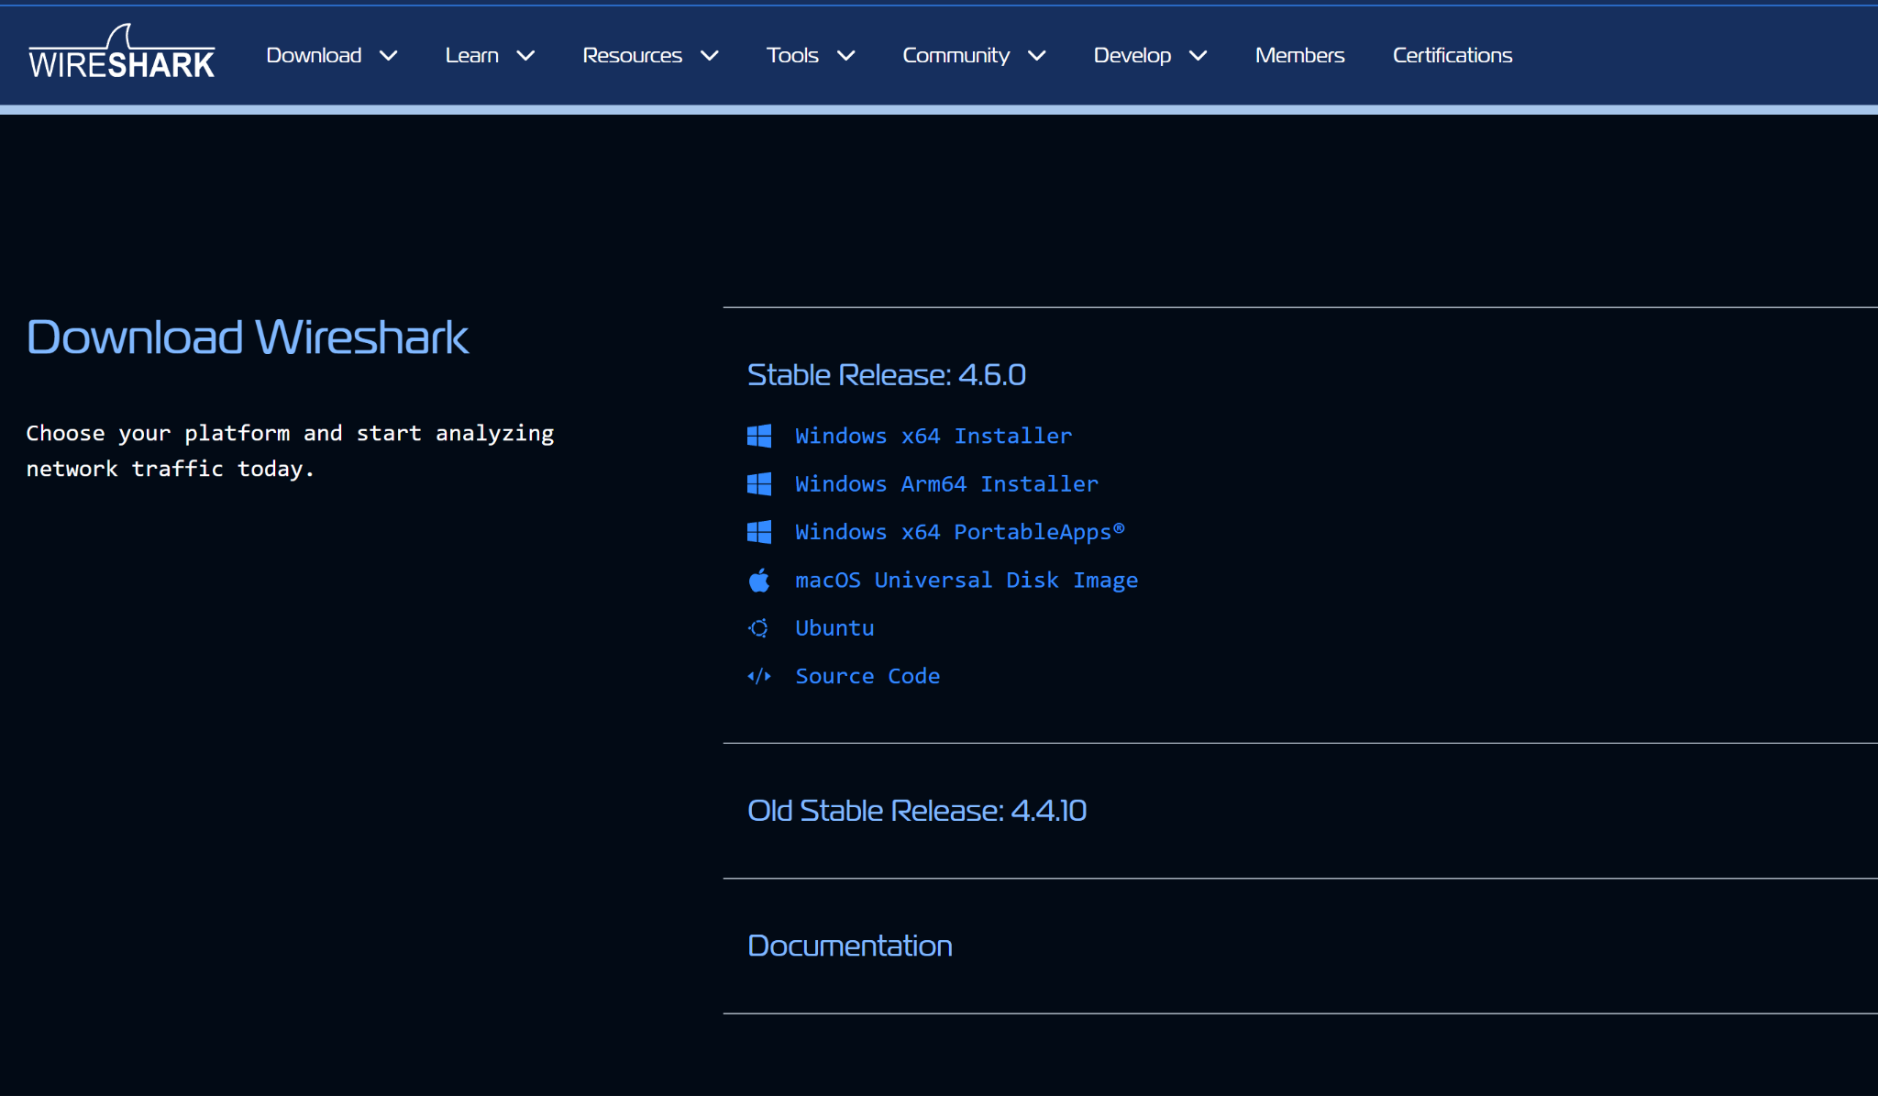
(01)

Slide 12
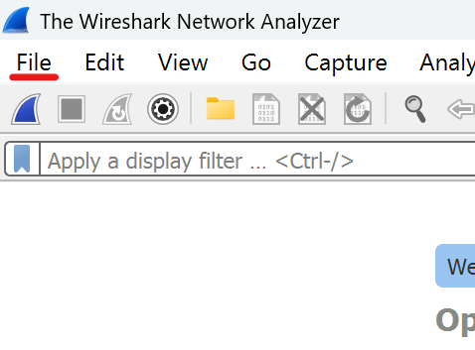
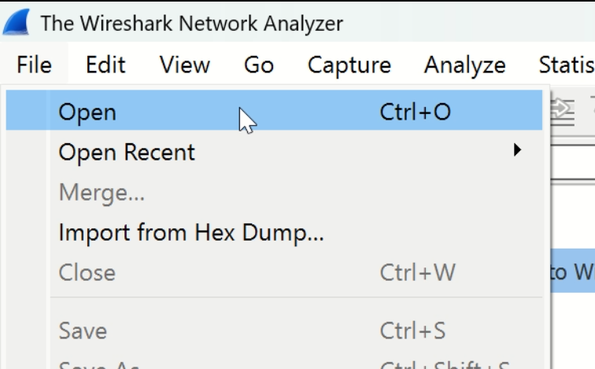
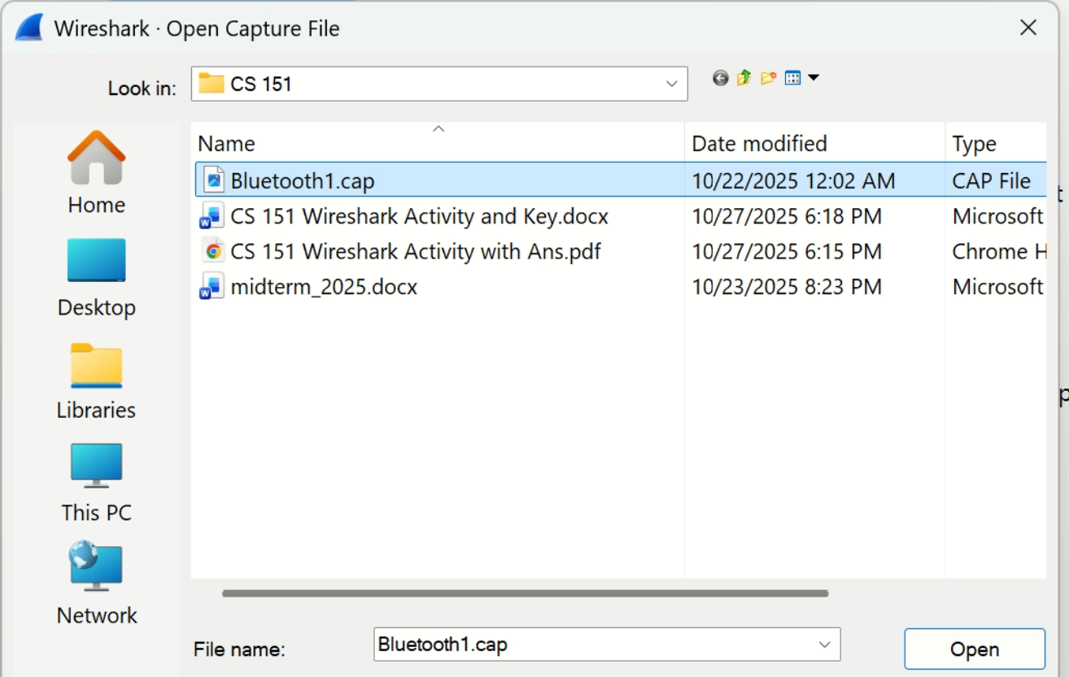
(02)

Slide 13
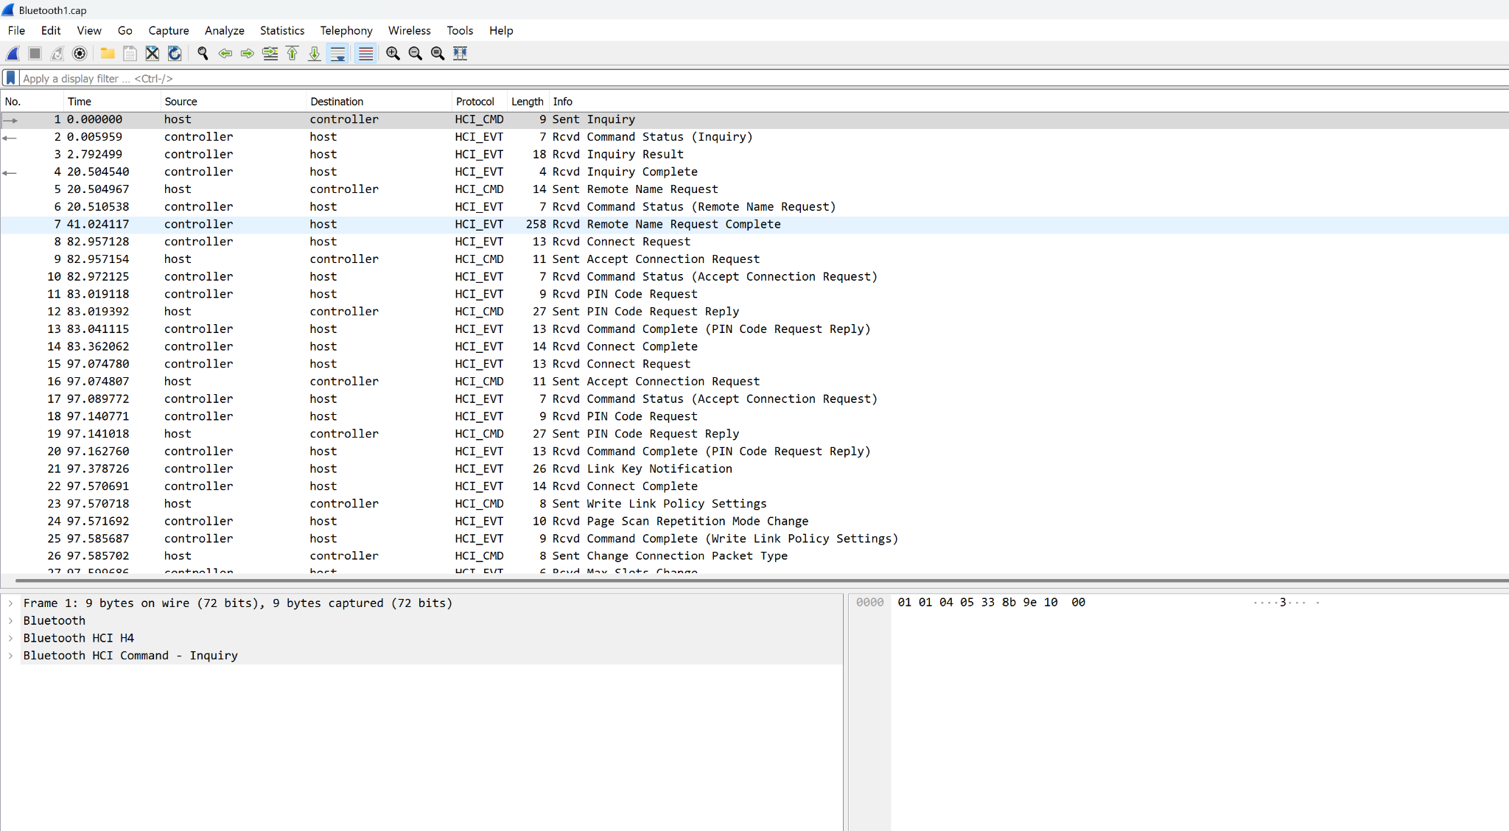
(03)

Slide 14

Wireshark Activity
(pssstt check WebCampus)

Slide 15
References
https://www.ezurio.com/resources/blog/bluetooth-low-energy-vs-bluetooth-classic-what-s-the-difference?srsltid=AfmBOopF3Mn79Uwjn_rimpsgZ50dcSdHcP_IsMKvZaaqkbUENoks6IMq
https://www.santander.com/en/stories/what-is-bluesnarfing

